Slide 1
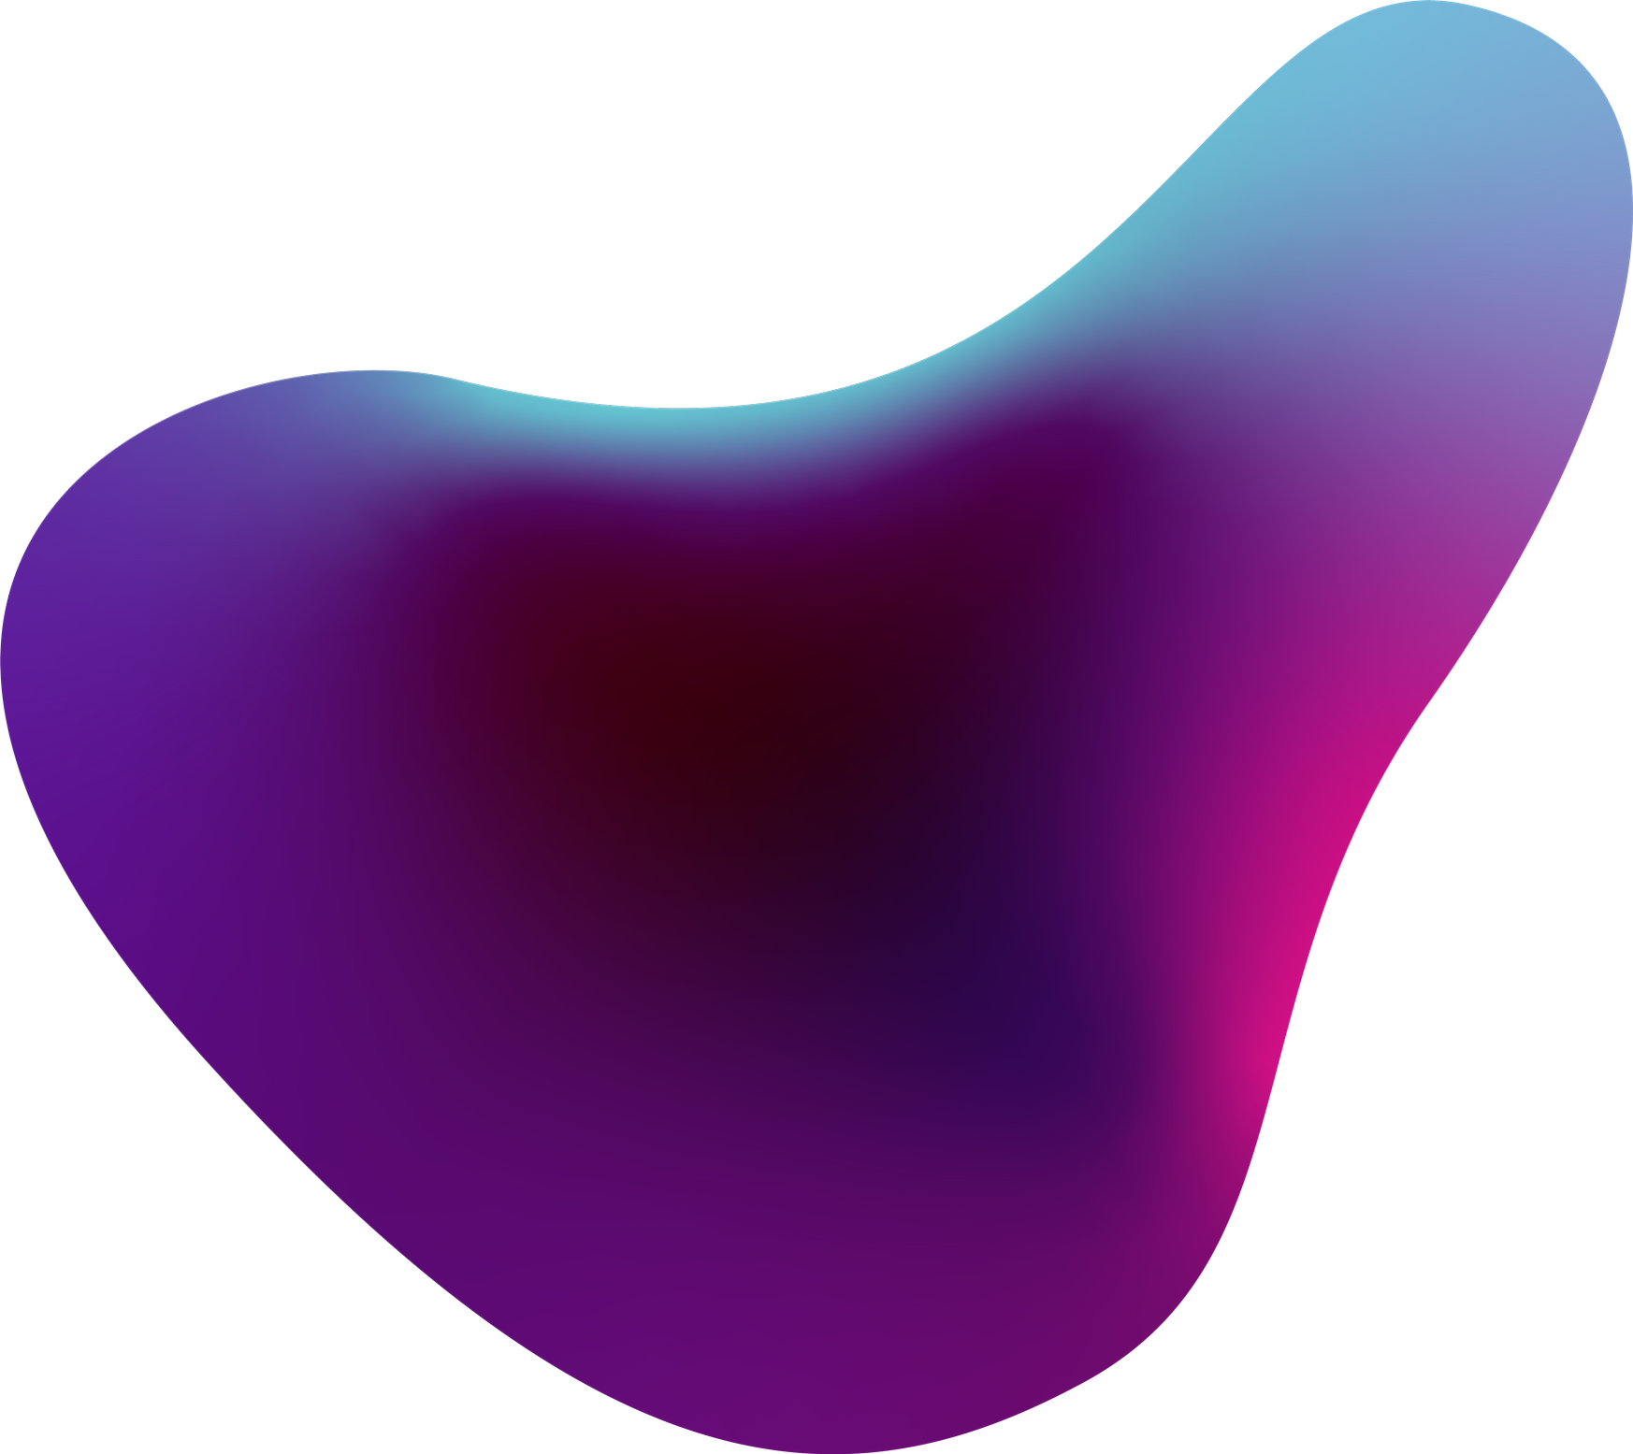

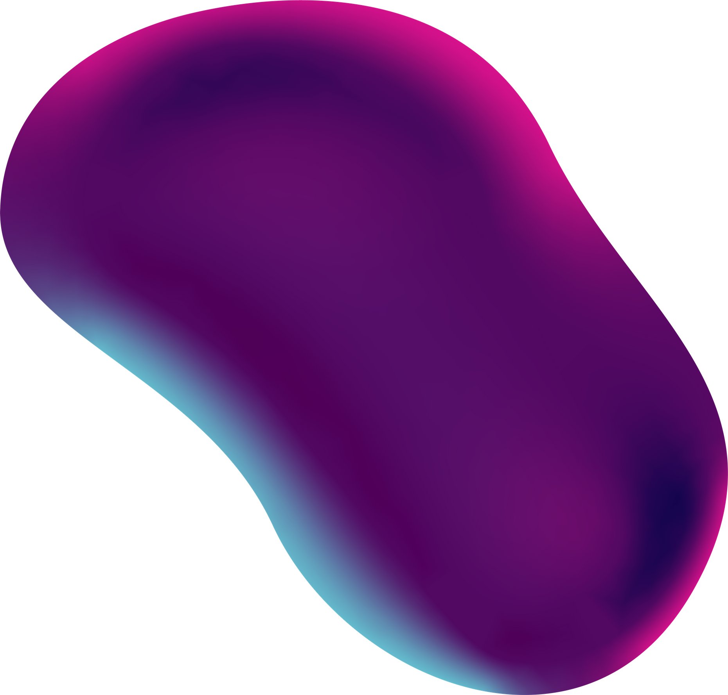
Detailed Solution Design and Architecture
Sevak

Slide 2


Introduction
The goal of Sevak is to create a smart IoT wearable that will
monitor the health of the underground drainage workers as
well as the environment in which they work.
This process of designing a solution covers:
Detailed design
Chosen hardware and software

Slide 3
Detailed Design
The detailed design will involve smart headgear and smart watch that will monitor the health of the worker as well as the working environment.

Slide 4
Features
Head Gear
Watch
Harmful gas detection
Obstacle detection
Alerts when harmful gas levels go beyond the threshold value
Temperature detection
Location of the workers using GPS
Heart and pulse rate sensing
Alerts when the pulse of the worker falls below the BPM level.
Emergency button in case he gets trapped
Fall detection

Slide 5
Description
Our products that include a head gear and watch monitor a variety of parameters that include temperature of the surroundings, obstacles, location, level of harmful gases(CH4 and CO) and pulse of the person using various sensors. In addition, it also has a fall detection sensor and an emergency button.

Slide 6
Description
These parameters are monitored real time. IBM Cloud is used for the analysis of real time data . It also creates alerts if the level of harmful gases cross a threshold value or if the pulse of the worker falls below normal BPM.
An emergency button that can be used by the workers to alert others in case he gets trapped.

Slide 7
Description
In addition a web application links the dashboard and employee database . All the parameters can be monitored from dashboard. The website acts a easy link for access by the admin and worker.

Slide 8
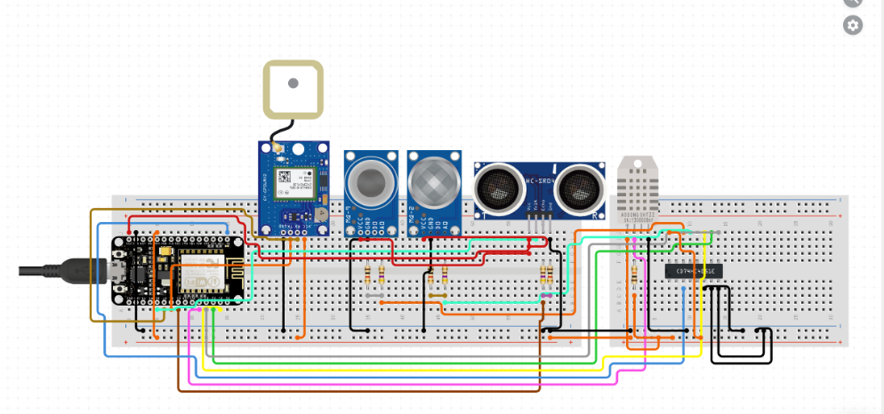
Circuit Diagram-Head Gear

Slide 9
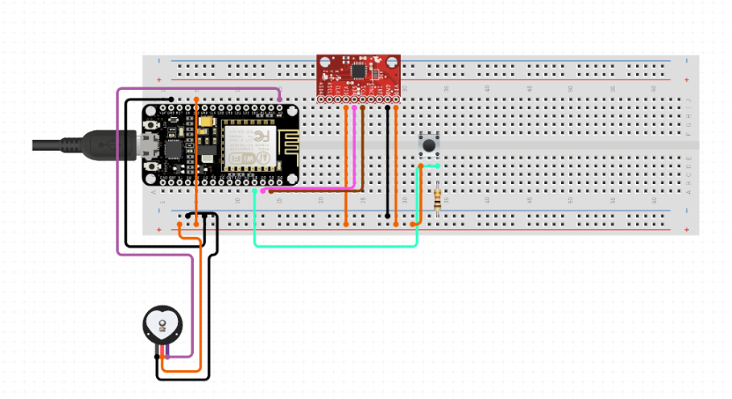
Circuit Diagram-Watch

Slide 10
Design Map
Creation of an IoT based sanitation worker safety system.
Head Gear
Watch
Temperature sensor(DHT22)
Pulse sensor(Sen 11574)
Real time data and alerts if needed managed by
IBM Cloud
Real time data and alerts if needed managed by
IBM Cloud
Gas Sensors(Mq2,Mq9)
Fall sensor(MPU6050)
GPS(Neo 6M)
Emergency button
Ultrasonic sensor

Slide 11
Detailed Design And Architecture
Dashboard and Alerts
Nodered
Twilio
GET
RESPONSE
NodeMcu acts as
Gateway
MQTT client
IBM IoT platform
MQTT Broker
Device Management
Cloudant Database
Sensor Data
Wifi and MQTT
Connector

Slide 12
What the user sees?
ADMIN
Dashboard and Alerts
LOGIN
WEBSITE
EMPLOYMENT REGISTRATION
USER

Slide 13
The sensor data is collected real time. Node mcu acts as a gateway and using mqtt is connected to IoT platform. The main dashboard and alert features are employed using node-red. A twilio node facilitates calls and sms alerts.
The user or the admin goes to the landing page of Sevak.He can login and hence can view the dashboard and alerts sent.The data is stored in database for future reference.
In addition there is an employment registration form that is considered a future scope of the project.
Design And Architecture

Slide 14
Sevak was developed to protect the lives of the sanitation workers.
It has been designed and developed to accommodate different sensors and gather data in real time
Conclusion

